Slide 1

Hawaii BAU – 21.03 - 01
by Team ‘Hawaii’

Slide 2
Stories for Today’s Showcase
P2OB - 11816 : As a CE, I should not be allowed to change the PPC/Partner Account for a lead that has already been shared with a Partner
P2OB-11848 : As a TPC user, I should be able to raise a case for the C.E to update the contact details for an Account
P2OB-12534 : As an Opportunity Owner, I want to be warned when my updated Close Date is after the Revenue Impact Date, so I can update it
P2OB-12545 : As a user with Read/Edit rights to the Work Order, I should not be able to remove or change Case reference from the Work Order record, so the relationship is intact
P2OB-12145 : As a Partner Manager, I should be able to edit the Partner Plan for my Partner Account
P2OB-12432 : As a Partner I want a resend SMS button in the PPV Tool so I can get a new OTP if there is an error in sending an SMS to the Cust Auth Rep
EDGE-193142 : CI || PRM || Issue with Partner Support Cases || Opportunity related to other Account linked to different Account
P2OB-12163 : As a Value Creation team member, I should be able to see all the cases assigned to my team queue in the list views
P2OB-12530 : As a Channel Manager/ AE once I share an opportunity with a Partner, I should be able to recall the opportunity before it has been accepted/ rejected by the Partner

Slide 3
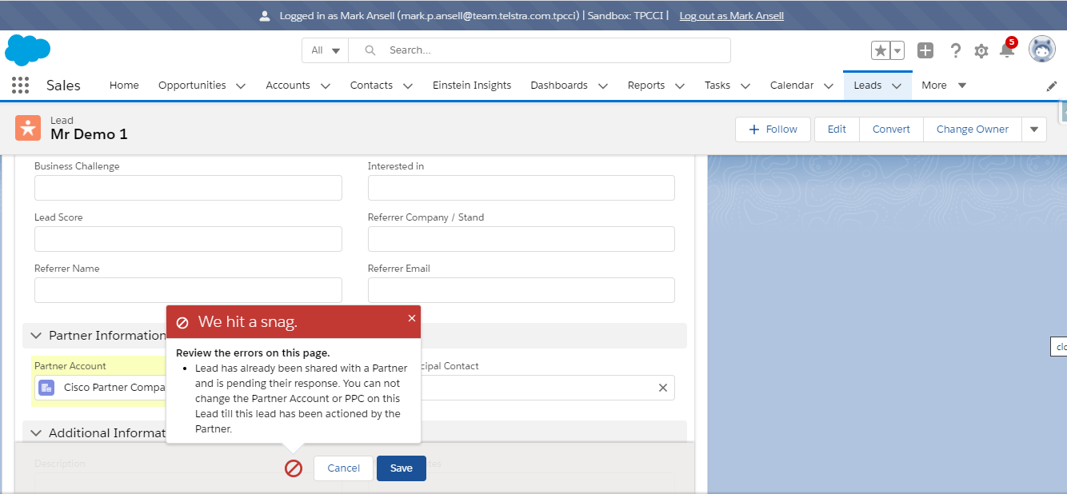
P2OB - 11816 : As a CE, I should not be allowed to change the PPC/Partner Account for a lead that has already been shared with a Partner

Slide 4
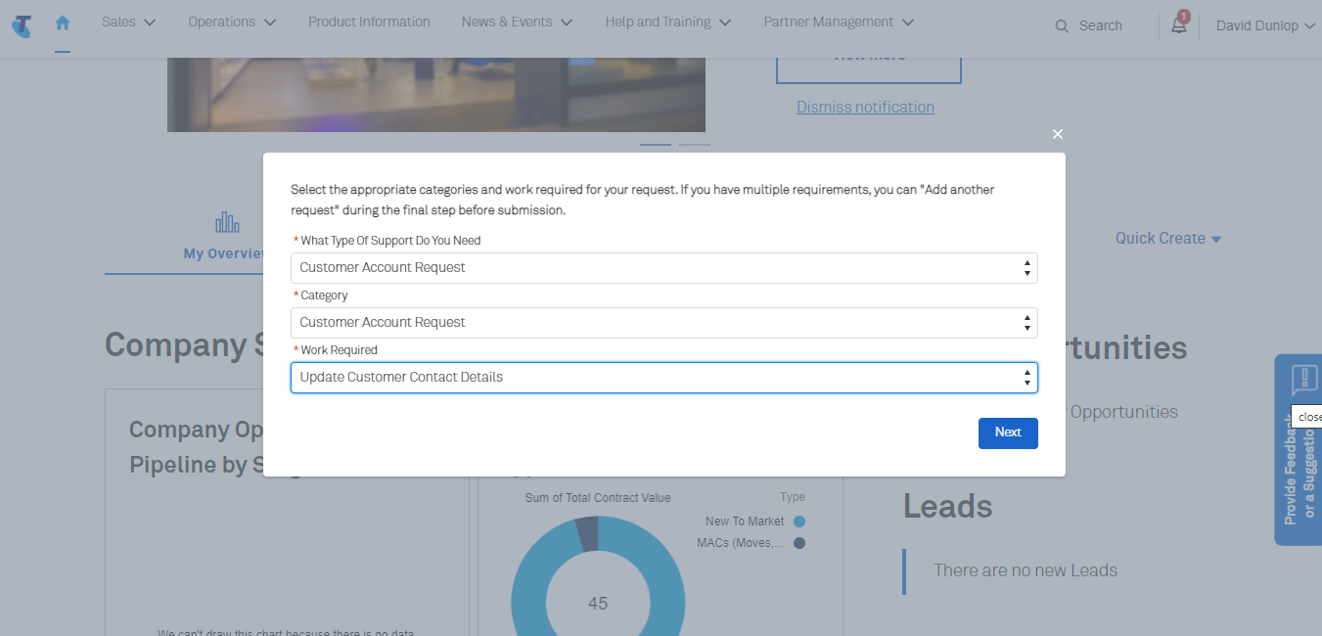
P2OB-11848 : As a TPC user, I should be able to raise a case for the C.E to update the contact details for an Account

Slide 5
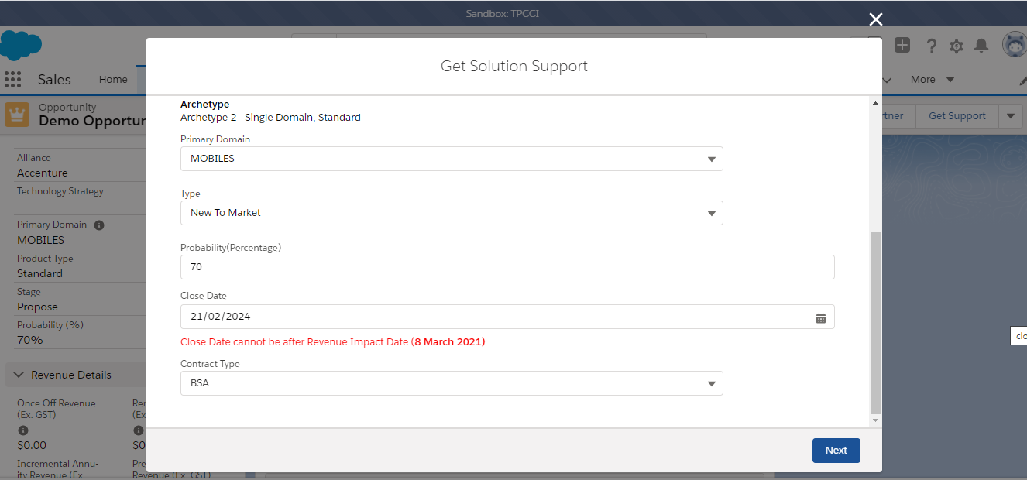
P2OB-12534 : As an Opportunity Owner, I want to be warned when my updated Close Date is after the Revenue Impact Date, so I can update it

Slide 6
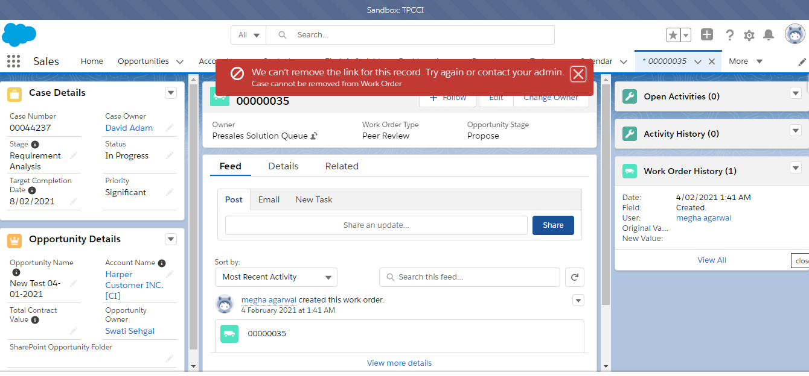
P2OB-12545 : As a user with Read/Edit rights to the Work Order, I should not be able to remove or change Case reference from the Work Order record, so the relationship is intact

Slide 7
P2OB-12145 : As a Partner Manager, I should be able to edit the Partner Plan for my Partner Account

Slide 8
P2OB-12432 : As a Partner I want a resend SMS button in the PPV Tool so I can get a new OTP if there is an error in sending an SMS to the Cust Auth Rep

Slide 9
EDGE-193142 : CI || PRM || Issue with Partner Support Cases || Opportunity related to other Account linked to different Account

Slide 10
P2OB-12163 : As a Value Creation team member, I should be able to see all the cases assigned to my team queue in the list views

Slide 11
P2OB-12530 : As a Channel Manager/ AE once I share an opportunity with a Partner, I should be able to recall the opportunity before it has been accepted/ rejected by the Partner

Slide 12
User Reference Guide
Presales Solution Pilot User : David Adam(Account Manager)
Presales Solution Queue members : Rob Alexander

Slide 13

Demo

